Slide 1
Mobile app dataset analysis
By: Mark Belikov

Slide 2
Goals of the project
The goal of the project is to find a dataset and answer questions that can help future app developers create a successful app on the app store.
We would find things that overlap and correlate to an app that is doing well.
To do this we will find the data set on kaggle and analyze to answers questions to make an app.
We will answer those questions by using matplotlib to get a visualization of the data collected.
Based on the findings you can then make recommendations for what one might do when time comes to building an app.

Slide 3
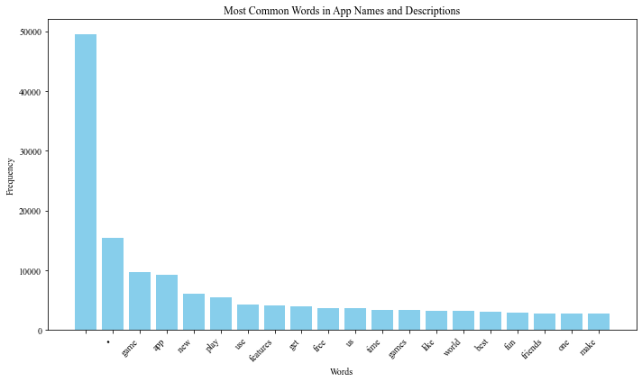
Data overview
Summary of the dataset is that it focused on the size and where the app ranks.
The questions that I wanted answered by using the data set were: How does an apps size determine where it ranks and the second question is what are the common words that apps use.
The graph does not show it but the most common words are free, new, play, app and game.

Slide 4
Data Analysis and Recommendations
Using the data from the previous graph users are more interested in things that are free and new because it is different.
Therefore, when a person is making a new game they should highly consider including words like that so that their app is more accessible and can be found.
For my first question there was no correlation although apps that are smaller in size like under 400 MB are higher in the ranking.
I have gathered that the size of your game does not matter as much but scale it under 500 MB so that people are able to download and space is not an issue on the users phone.

Slide 5
Future Work
In the future I would want to look through other data sets to see if I would be able to answer other questions.
That are related to user reviews and downloads.
As I think that would be more beneficially and makes more of an impact of a user downloading your app if it has good reviews or not.
Users are also able to see how many downloads your app has so if your app does not have many downloads most people are going to stay away from it.

Slide 6
Conclusion
Ultimately, using this dataset I was able to find an important insight that could possibly help people make a new app.
The words that you choose although do not seem important on the outside could heavily impact how your app performs.
The app developers needs to include new, or free, or even app.
So that they are able to gain traction and more people would be able to find them.

